Slide 1


Criminal Cases in Malaysia: An Overview
We will investigate several prominent criminal cases in Malaysia, examining the investigative processes and judgments within the country's criminal justice system.
by Afiq Akmal

Slide 2
Introduction to Criminal Investigation in Malaysia
Definition of Criminal Investigation
Purpose of Investigation
Criminal investigation refers to the systematic process of collecting and analyzing evidence to determine whether a crime has occurred and who is responsible.
The main purpose of criminal investigation is to identify the perpetrator, present solid evidence, and ensure that justice is served.
Investigation Process
Authorities
The criminal investigation process typically involves steps such as interviewing witnesses, collecting physical evidence, and analyzing data.
Criminal investigations in Malaysia are usually conducted by the Royal Malaysian Police (PDRM) and the Criminal Investigation Department (JSJ).

Slide 3



Case 1 - Homicide: Canny Ong (2003)
1
Background
2
Investigation Process
Canny Ong's abduction from a Kuala Lumpur shopping mall on June 13, 2003, shocked the community. Her subsequent murder sparked a swift and intensive investigation.
CCTV footage, forensic evidence (fingerprints and DNA), and witness testimonies were crucial in identifying Ahmad Najib Aris as the prime suspect.
3
Conviction
Overwhelming evidence led to Aris's conviction for murder. He was sentenced to death, reflecting the severity of the crime under Malaysian law.

Slide 4


Case 2 - Rape: Nurin Jazlin Jazimin (2007)
Background
Investigation Process
Outcome
Nurin Jazlin Jazimin, an eight-year-old girl, was abducted from her home in September 2007. Her disappearance sparked a massive search effort. The case became a national tragedy when her body was found days later, revealing she had been subjected to a brutal sexual assault and murder. The crime caused widespread public outrage and concern about child safety in Malaysia.
The investigation involved extensive forensic analysis of the crime scene and the victim's body. The Royal Malaysian Police (PDRM) collaborated with international agencies, utilizing advanced techniques in DNA analysis and digital forensics. Witness interviews were conducted, and potential leads were thoroughly investigated. However, despite these efforts, critical evidence proving the identity of the perpetrator remained elusive.
Despite the extensive investigation, the perpetrator of Nurin Jazlin's rape and murder remains unidentified to this day. This case serves as a stark reminder of the challenges in solving complex sexual assault cases, particularly when crucial evidence is limited or difficult to obtain. It also highlights the need for continuous improvements in forensic techniques and investigative methodologies in combating such crimes.

Slide 5



Case 3 - Assault: Muhammad Rizalman Ismail (2014)
Background
Investigation Process
Conviction
Muhammad Rizalman Ismail, a Malaysian diplomat, was accused of assaulting a New Zealand woman with intent to rape. The incident occurred in Wellington, New Zealand, causing significant diplomatic tension between the two countries. The case attracted considerable media attention due to Rizalman's diplomatic immunity and the subsequent legal battles.
The investigation involved close collaboration between New Zealand and Malaysian authorities. New Zealand police collected forensic evidence, including DNA samples, and took detailed statements from the victim. The Malaysian government cooperated in the investigation, but the process was complicated by the diplomatic immunity afforded to Rizalman. The legal complexities surrounding his immunity were a central focus of the proceedings.
To avoid extradition proceedings and potential lengthy legal battles, Rizalman eventually pleaded guilty to a charge of assault. This resulted in a sentence of nine months' home detention in Malaysia, a decision that sparked debate about the appropriateness of the punishment in light of the severity of the original accusation.

Slide 6




Slide 7


Case 4 - Kidnapping: Pastor Raymond Koh (2017)
1
Background
Pastor Raymond Koh, a prominent human rights activist, was abducted on February 13, 2017, in broad daylight in Petaling Jaya, Selangor. The abduction was swift and efficient, suggesting a well-planned operation involving multiple individuals and vehicles. His disappearance sparked widespread outrage and concern regarding human rights and the rule of law in Malaysia.
2
Investigation Process
The investigation involved extensive analysis of CCTV footage which captured images of several vehicles involved in the abduction. The footage, coupled with witness testimonies (though limited), enabled investigators to piece together a partial timeline of events. However, the identities of those responsible remained elusive. Public speculation and reports in the media linked the possible involvement of several groups, leading to a complex and challenging investigative landscape.
3
Outcome
Despite numerous investigations and the efforts of various agencies, the case of Pastor Raymond Koh's disappearance remains unresolved. The lack of concrete evidence and the complexity of the operation led to ongoing investigations and uncertainty surrounding the case. His family and supporters continue to call for justice and a transparent resolution.

Slide 8

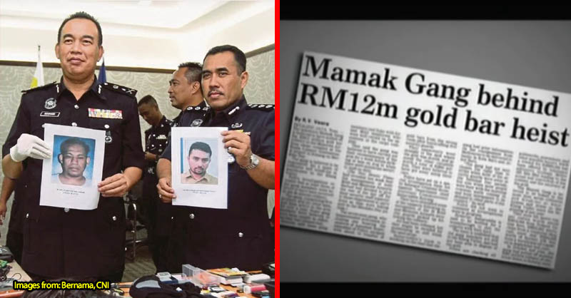



Case 5 - Robbery: The Great Malaysian Bank
Heist (1994)
Background
In 1994, a sophisticated robbery targeted a major Malaysian bank, resulting in the theft of millions of ringgit. The heist was meticulously planned, involving insider knowledge and advanced techniques to bypass security measures. The scale of the theft shocked the nation and triggered a major criminal investigation.
Investigation Process
The investigation involved a multi-agency approach, combining forensic analysis of the crime scene with extensive surveillance footage review. Investigators meticulously pieced together the timeline of events, identifying key players and tracing the flow of stolen funds. Crucially, information gathered from informants played a significant role in narrowing down the suspects and providing critical leads.
Conviction
Following a lengthy investigation, the perpetrators were apprehended. The evidence gathered, including forensic analysis linking them to the crime scene and financial records tracing the stolen money, proved overwhelming. They faced trial and received substantial prison sentences, reflecting the seriousness of their crime and sending a strong message about deterring similar actions.

Slide 9
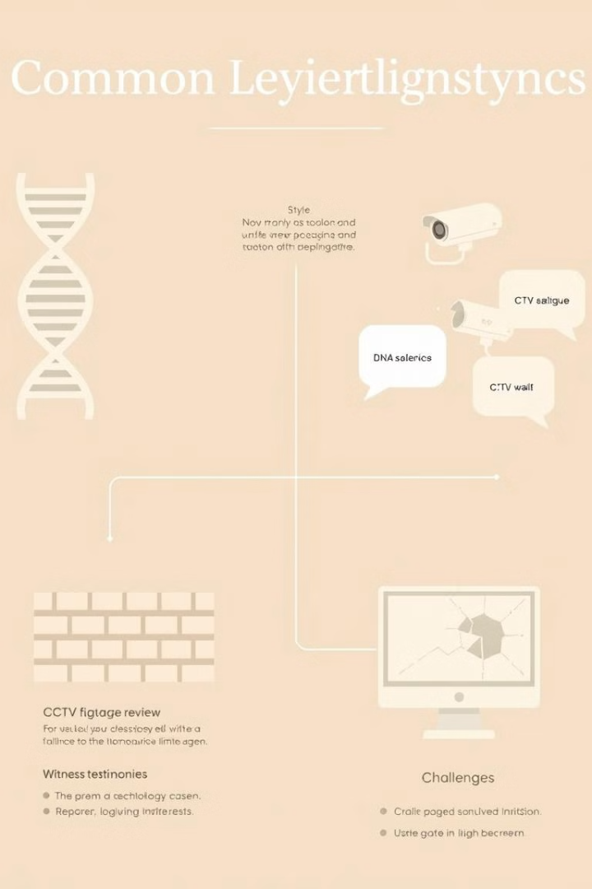
Common Themes in Investigations
1
Common Techniques
2
Challenges
Unsolved cases and technological limitations.
The use of CCTV and surveillance, forensic evidence, and public cooperation and witness statements.

Slide 10



Achieving Justice Through Investigation
Importance of Investigation
1
Crucial for solving crimes and achieving justice.
Technological Advancements
2
Advanced technology aids in investigation and prosecution.
Improvements
3
Malaysia's criminal justice system can be improved to reduce unresolved cases.

Slide 11
Achieving Justice: A Concluding Thought
Criminal investigations in Malaysia are paramount for upholding justice and maintaining societal order. These investigations rely on a diverse range of techniques and resources, from traditional methods like witness testimonies and forensic analysis to modern technologies such as CCTV footage and DNA profiling. The effectiveness of these investigations significantly impacts the ability of the Malaysian justice system to deliver fair and equitable outcomes.
The cases examined in this presentation highlight both remarkable successes and significant challenges in achieving justice within the Malaysian criminal justice system. Successful convictions, like that in the 1994 bank robbery case, showcase the power of thorough investigation, effective collaboration, and the utilization of available evidence. However, unsolved cases like the Nurin Jazlin case and Pastor Raymond Koh's abduction underscore the limitations encountered, including resource constraints, the complexities of legal procedures, and the ever-evolving nature of criminal tactics.
Addressing these challenges requires a multi-pronged approach. This includes increasing investment in forensic capabilities and investigative training, improving inter-agency collaboration (both domestically and internationally), and fostering greater public trust and cooperation. The legal framework itself could also benefit from review to ensure it remains effective and efficient in dealing with the complexities of modern crime. By addressing these issues, Malaysia can strive toward a more just and equitable criminal justice system.

